Slide 1


Catalysts of change
Presented by:
Darrell Bricker, Ph.D.

Slide 2


Slide 3

Humanity Evolving…
3

Slide 4
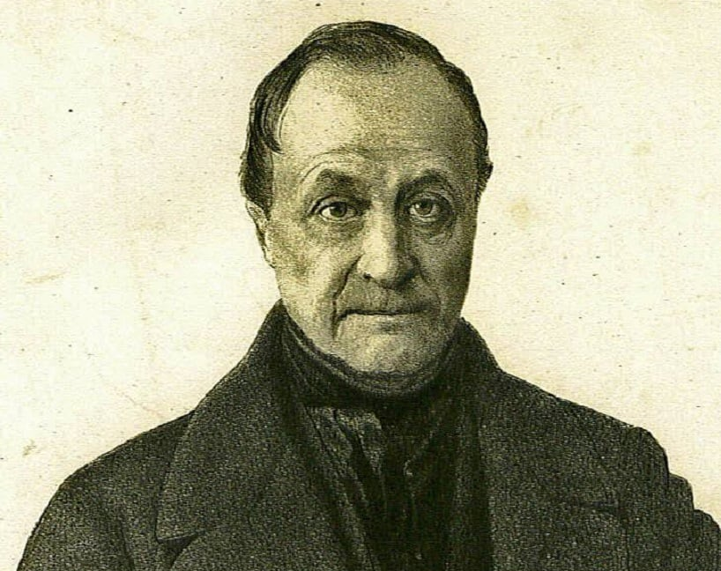
“Demography is Destiny”
Auguste Comte

Slide 5
Population Dystopia…
Population Bomb explodes:
8B today to 10.4B (or more) by 2100.
We’re having too many babies.
Unsustainable population growth will destroy our planet.
Power of youth will dominate our future – they are your top priority market.

Slide 6
EMPTY PLANET
10
IT JUST AIN’T SO….

Slide 7
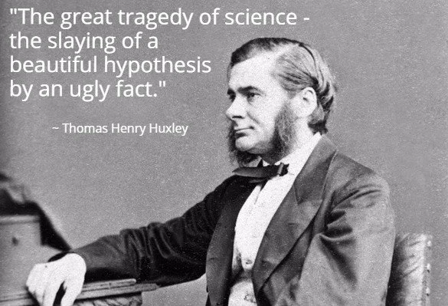

Slide 8

Demographic Facts…
EMPTY PLANET
About us
Better measurement
Decisions already made
Projectable
Facts – can disagree about speed and levels, but trends undeniable

Slide 9
EMPTY PLANET
10
Global Population will Peak
Mid-Century, Decline to
Where it is Today, or Fewer...

Slide 10
EMPTY PLANET
11
Top 10 Countries by Population 2017 vs 2100
2017
2100
China | 1.40B
India | 1.38B
U.S. | 325M
Indonesia | 258M
Pakistan | 214M
Brazil | 212M
Nigeria | 206M
Bangladesh | 157M
Russia | 146M
Japan | 128M
India | 1.09B | 290M
Nigeria | 791M | 585M
China | 732M | 668M
USA | 336M | 11M
Pakistan | 248M | 34M
DR Congo | 246M | 165M
Indonesia | 229M | 29M
Ethiopia | 223M | 120M
Egypt | 199M | 103M
Tanzania | 186M | 132M
Source: Lancet July 14, 2020

Slide 11
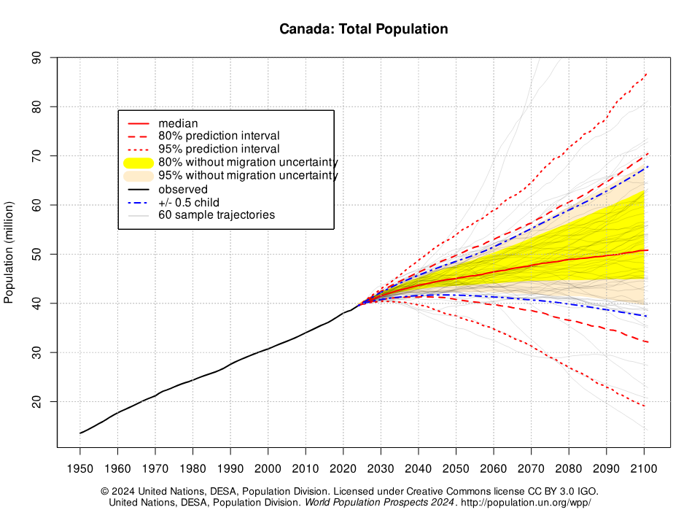


51M

Slide 12
Why is This Happening?
EMPTY PLANET
Urbanization
Fertility
Aging

Slide 13

Urbanization
© Ipsos | Futurecasting | November 2024 | Client Use Only | Strictly Confidential
13

Slide 14

Biggest Migration in Human History…
EMPTY PLANET
% of the World’s Population Living in Urban Areas
1960
Today
2050

Slide 15
Urbanization for 10 Most Populous Countries
EMPTY PLANET
1960 – 34%
Today – 57%
2050 – 68%

Slide 16
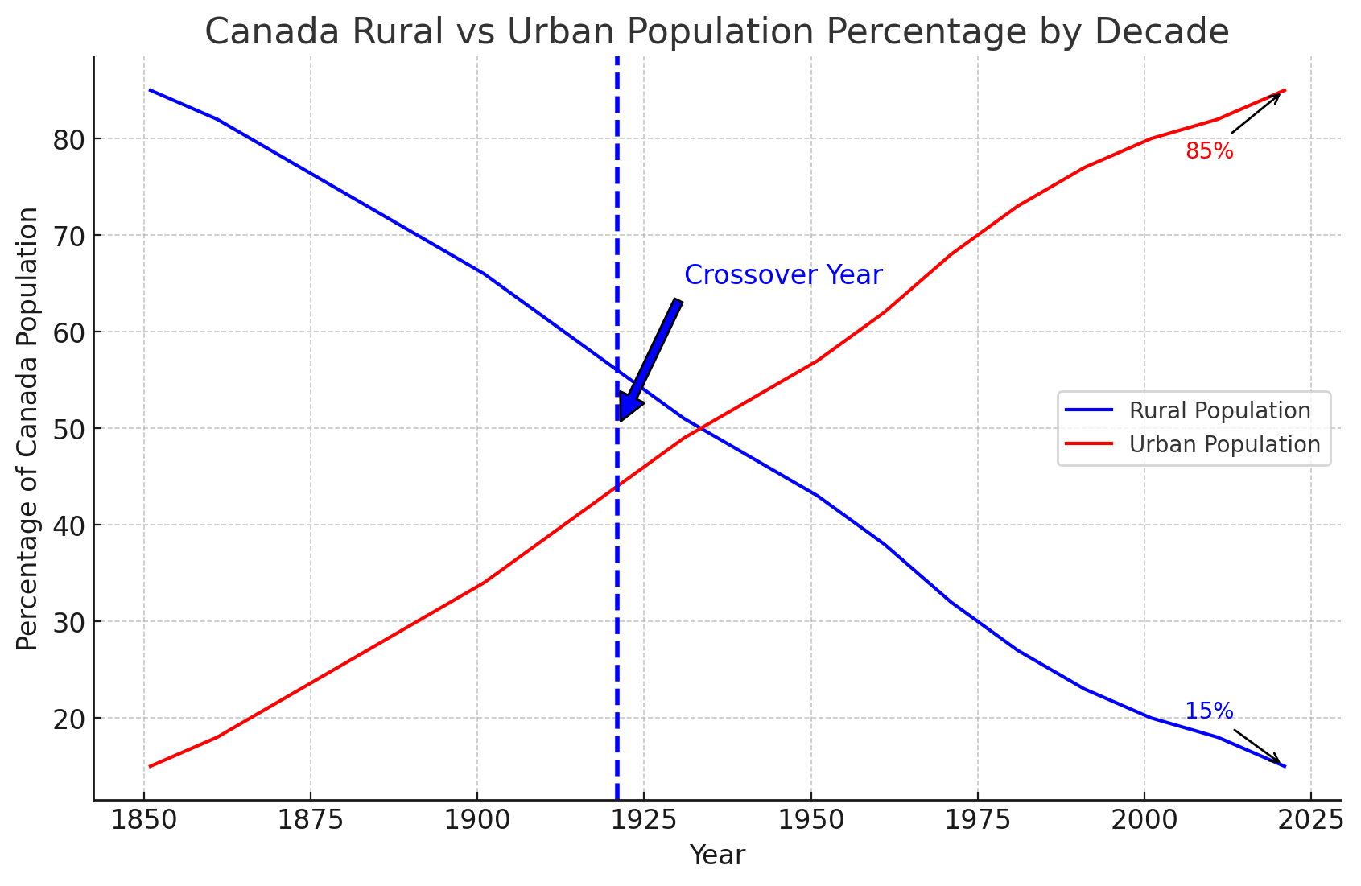
Canada Rural vs Urban Population by Decade

Slide 17
Canada’s Regions by Share Of Population

Slide 18
Where Canadians Live
2021

Slide 19
Ten Fastest Growing Canadian Cities (2000-2024)
Growth Percentage

Slide 20
Heartlands Shifting
EMPTY PLANET
Global trends.
Canada: growing West, declining East.
Expanding suburbs, stagnant downtowns.
Happening before COVID…

Slide 21

FERTILITY
© Ipsos | Futurecasting | November 2024 | Client Use Only | Strictly Confidential
21

Slide 22
Replacement Rate
EMPTY PLANET
2.1

Slide 23
Fertility Will Continue to Decline…
EMPTY PLANET
1960 – 4.7 avg.
Today – 2.3 avg.
2050 – 2.2 avg.

Slide 24
EMPTY PLANET
21
Lowest Fertility Rate in Canadian History
1.3

Slide 25

Why is Fertility Declining?
Urbanization
Empowerment of women
Focus on autonomy
Flight from marriage
Success of Government, NGO programs
Gender and age structure of population

Slide 26
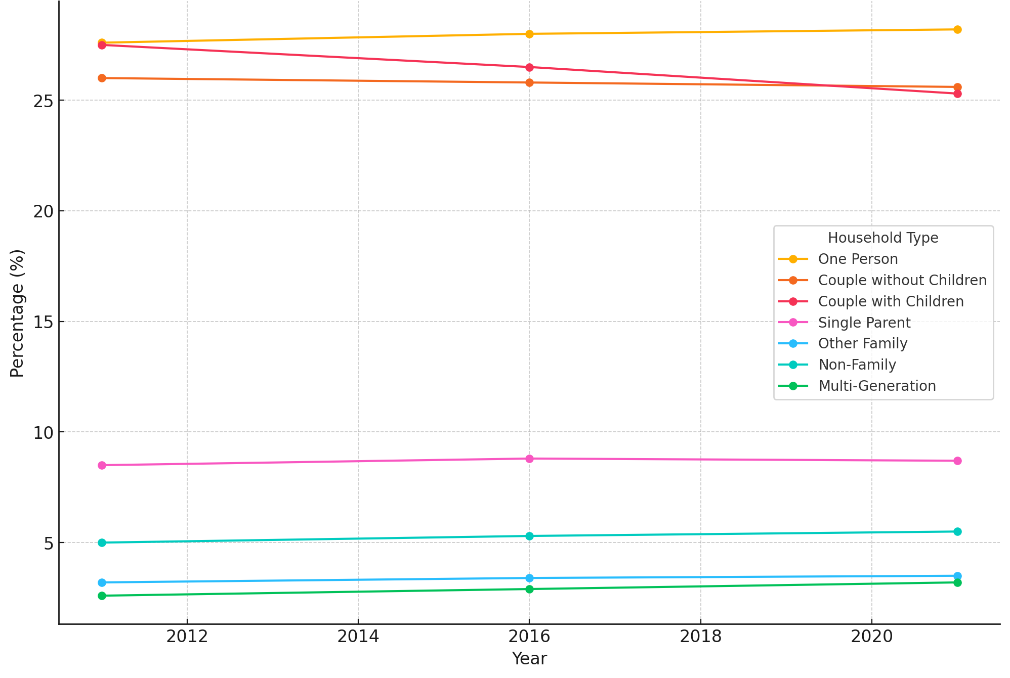
Trends in Household Composition in Canada (2011-2021)

Slide 27
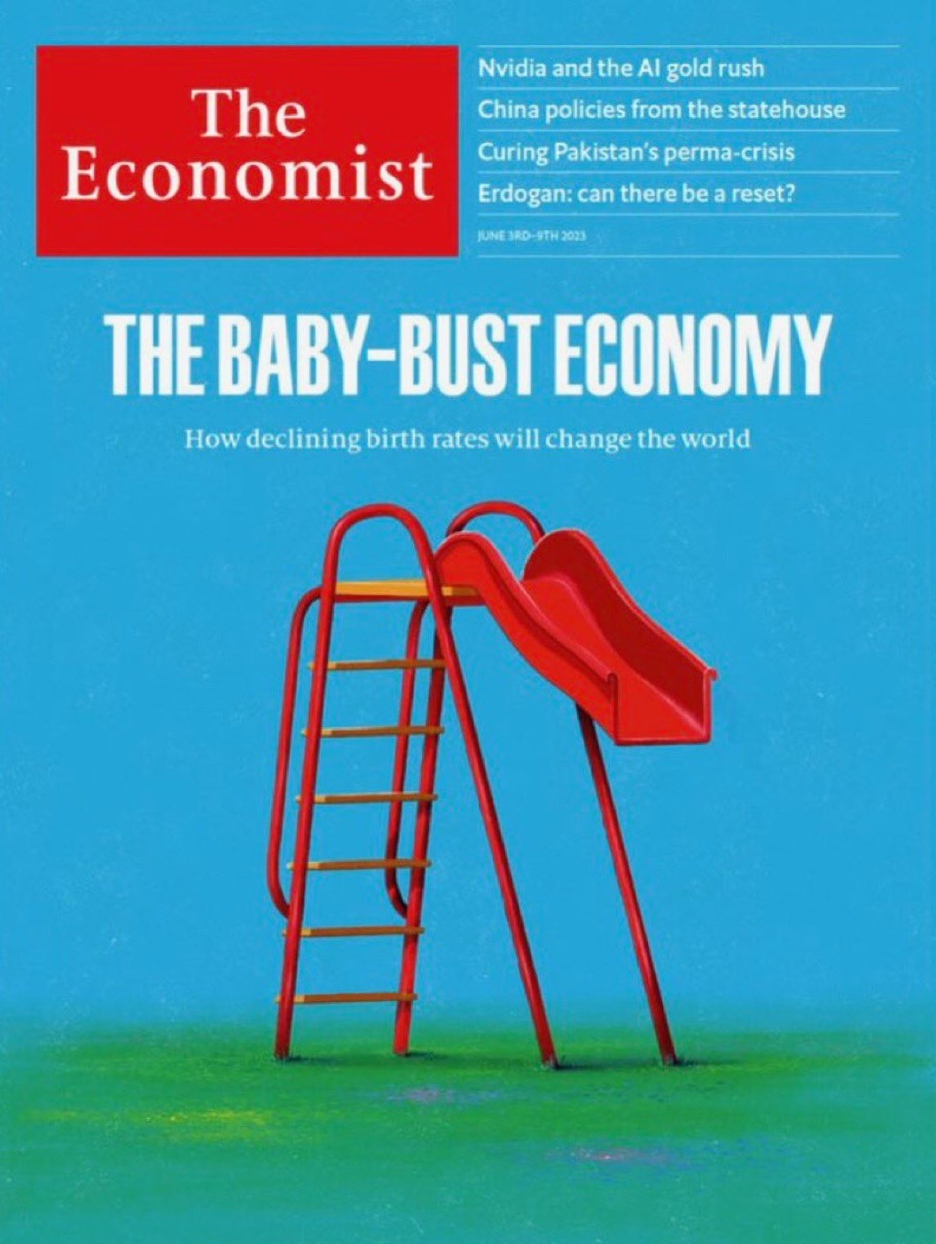

Slide 28

AGING
© Ipsos | Futurecasting | November 2024 | Client Use Only | Strictly Confidential
28

Slide 29
Life Expectancy | World’s 10 Most Populous Countries
EMPTY PLANET
1960 – 48 avg.
Today – 73 avg.
2050 – 77 avg.

Slide 30
Average Lifespan Of Canadians

Slide 31
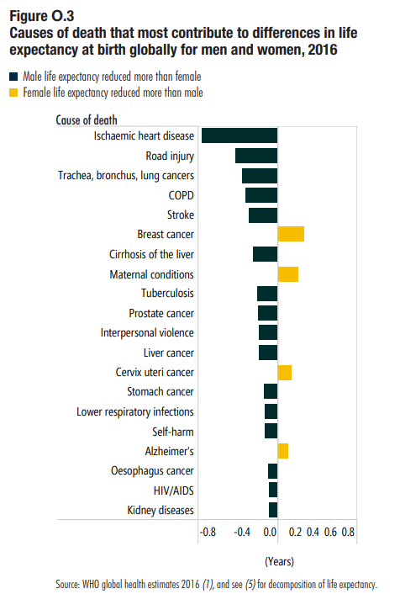
Causes of Death that Most Contribute to Differences in Life Expectancy at Birth Globally for Men and Women, 2016
Source: WHO global health estimates 2016.

Slide 32
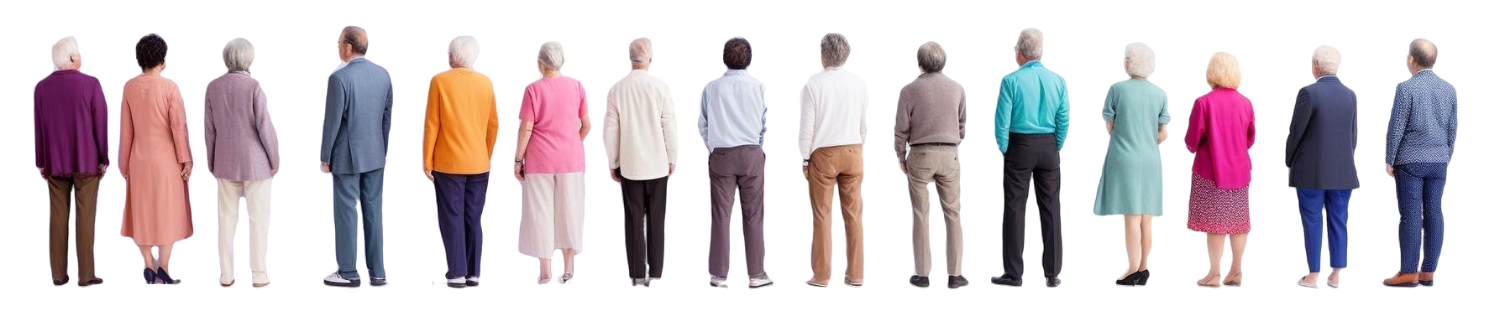
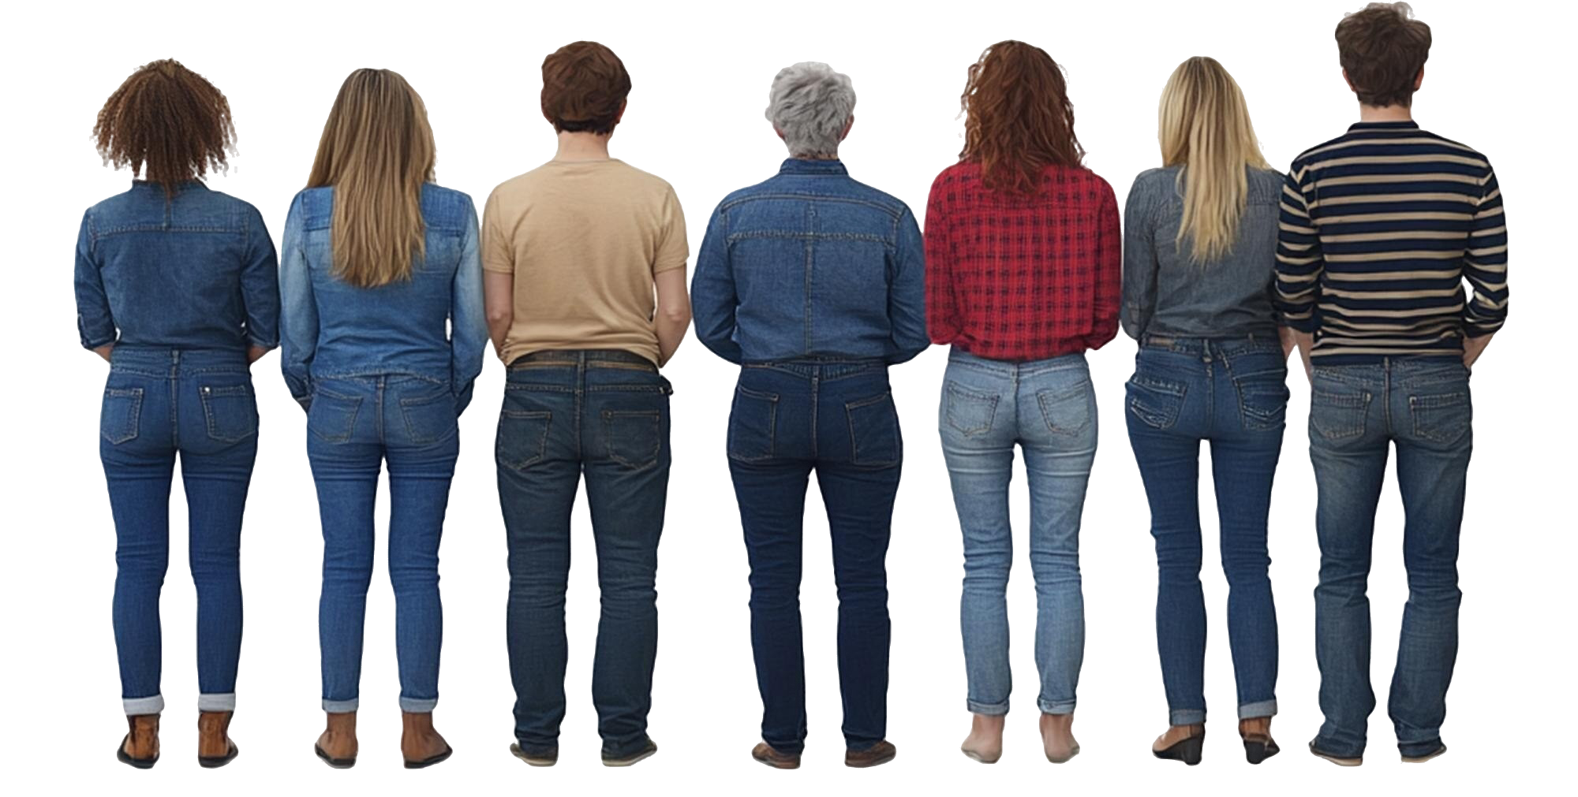

Flipping the Pyramid…

Slide 33

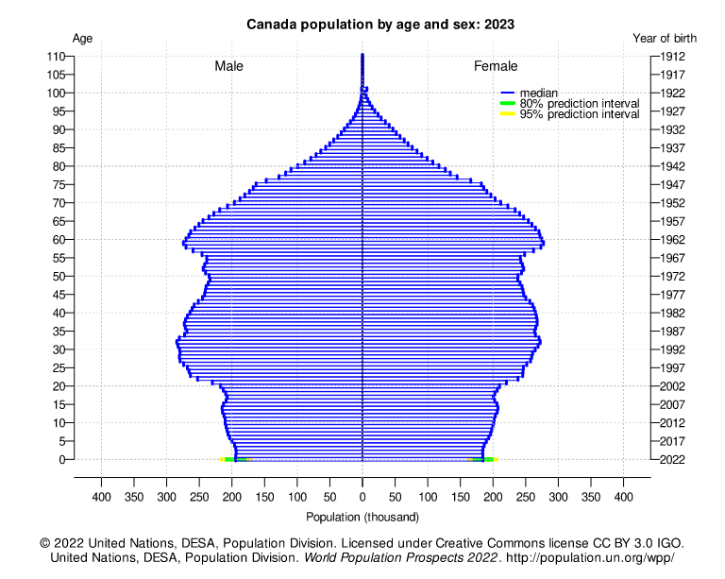
CANADA population by age and sex
CANADA
Median Age | 41
Longevity | 82
Percentage 65+ | 20%
Fertility Rate | 1.3
Peak Fertility | 3.93 (1959)
Below Replacement | 1972

Slide 34
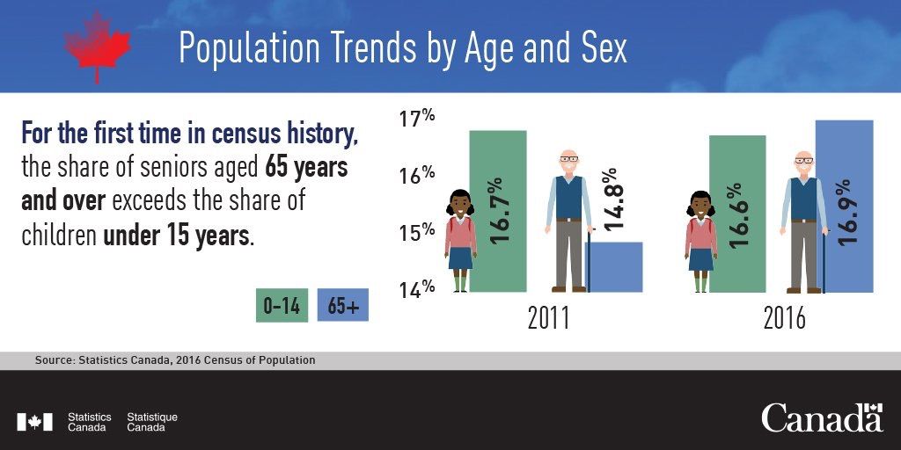
More Seniors Than Kids…
© 2024 Ipsos

Slide 35
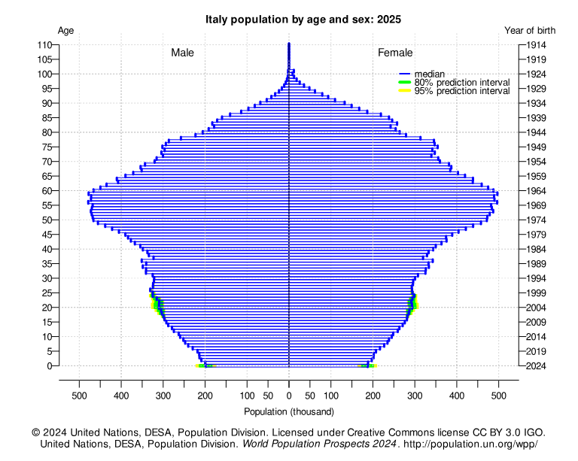
Italy population by age and sex
ITALY
Median Age | 47
Longevity | 84
Percentage 65+ | 24%
Fertility Rate | 1.3
Peak Fertility | 2.65 (1964)
Below Replacement | 1976

Slide 36
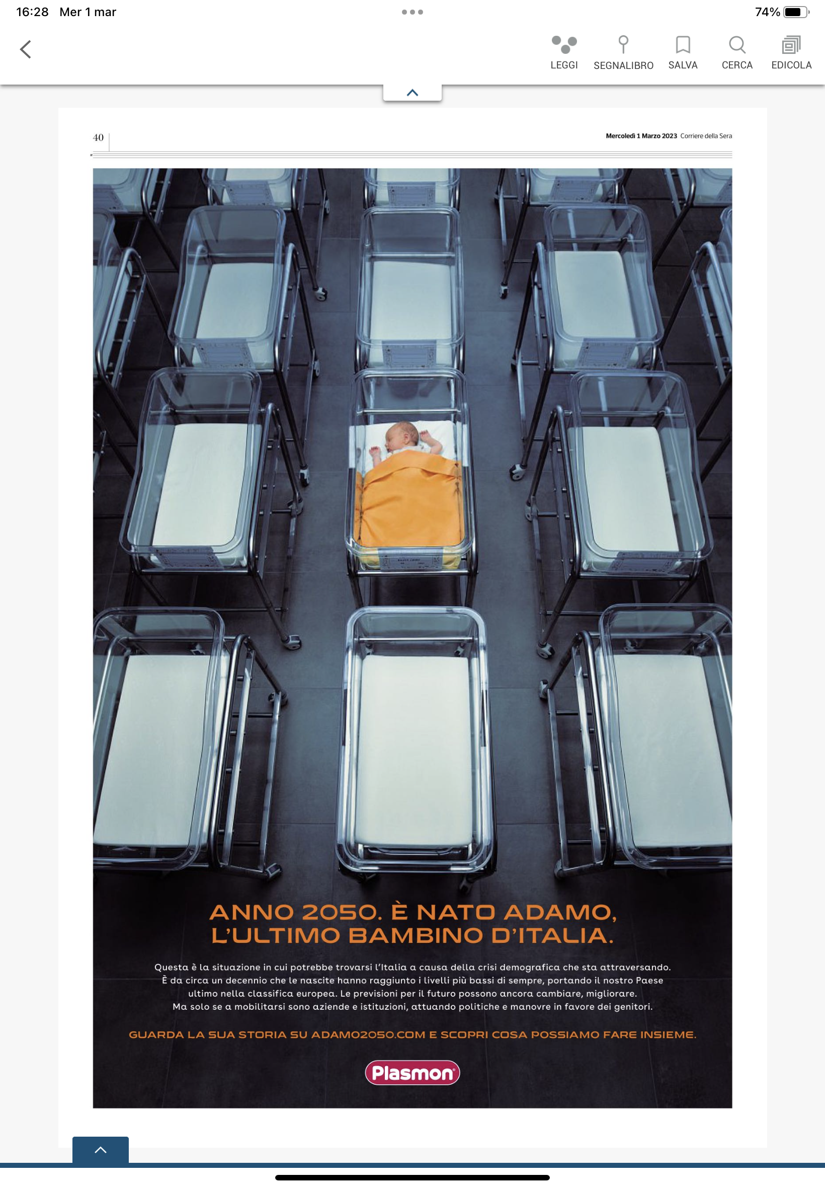

Slide 37
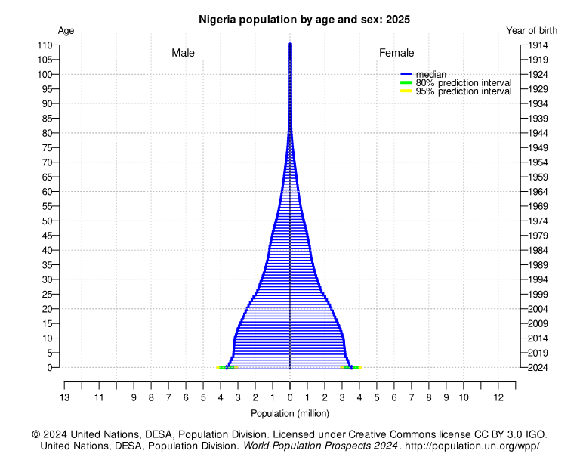

NIGERIA population by age and sex
NIGERIA
Median Age | 17
Longevity | 55
Percentage 65+ | 3%
Fertility Rate | 5.14
Peak Fertility | 6.89 (1979)
Below Replacement | NA

Slide 38

IMMIGRATION
The Solution?
© Ipsos | Futurecasting | November 2024 | Client Use Only | Strictly Confidential
38

Slide 39
Percentage of Canadian Population Foreign Born

Slide 40
Top 10 Countries Of Birth Of
New Permanent Residents To Canada
1970
2024

Slide 41
Share Of Population, Share Of Immigrants

Slide 42
9 OF 10 IMMIGRANTS LIVE IN URBAN CANADA
POPULATION LIVING IN A LARGE URBAN AREA

Slide 43
IMMIGRATION AND DIVERSITY:
2036
30% Immigrants
50% Immigrants + Canadian born children
30% Other mother tongue
40% Visible minority
16% Non-Christian religion

Slide 44

Where to from here?
© Ipsos | Futurecasting | November 2024 | Client Use Only | Strictly Confidential
44

Slide 45


33
Decades of
Disruption…
The Great Retirement (2030): Every Boomer 65 or older.
The Great Decline (2040s): Final decade for Boomers.

Slide 46
Key Takeaways…
1. Population is Aging – Market is Changing
2. Suburbanization is Reshaping Car Ownership
3. Fertility Decline = Fewer New Young Drivers
4. Immigration is Canada’s Growth Engine
5. The ‘Great Retirement’ Will Reshape the Industry

Slide 47
Final Thought…
The Future of Mobility is Evolving: Success will come from selling smarter — understanding changing consumer demographics, adjusting to new mobility trends, and adapting to emerging opportunities.
Dealers who recognize these shifts and pivot accordingly will be the ones who thrive in this new reality.

Slide 48


Slide 49


THANK YOU
Thank you page Option One – image may be changed as necessary
Darrell Bricker, Ph.D.
Darrell.Bricker@Ipsos.com

